Slide 1
RFID based activities of daily living recognition
F. Bergeron, K. Bouchard, S. Giroux, S. Gaboury

Slide 2
Outline
Context
Indoor tracking
Activity modelling
Activity recognition

Slide 3
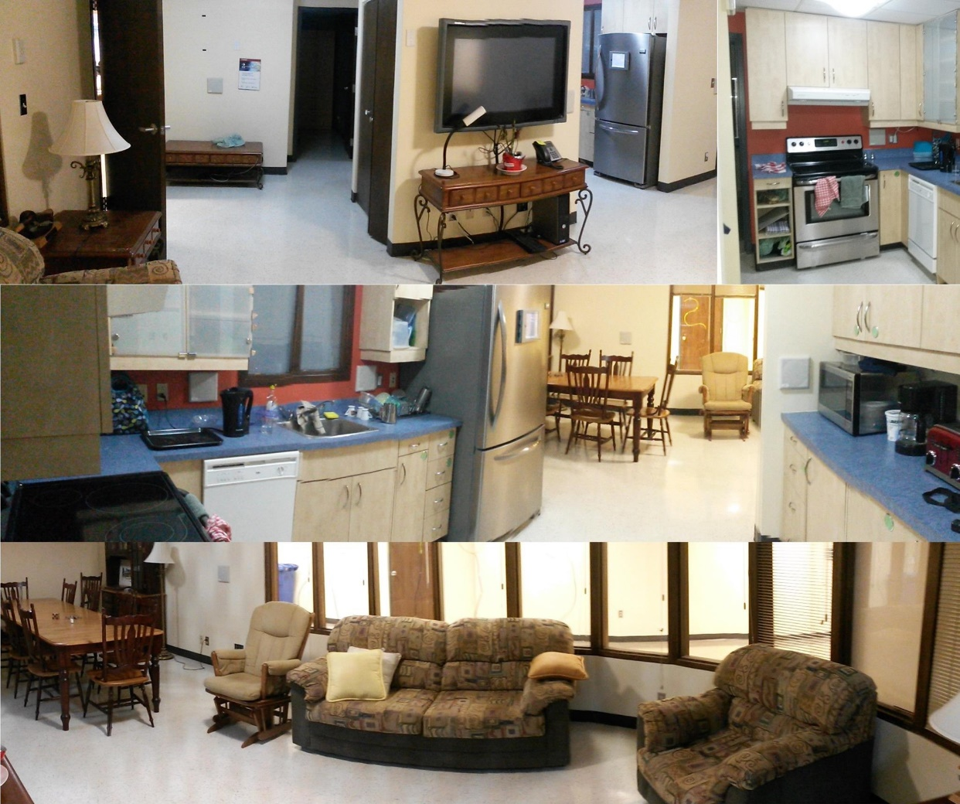
Context
Create an assistive smart home
Security system
Activity recognition system
Feedback system

Slide 4
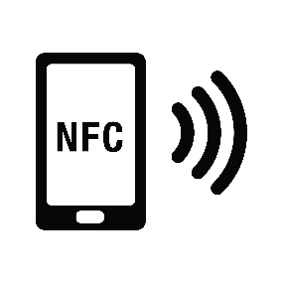
Context
Non-intrusive technologies
RFID, NFC, Wi-Fi, …
Flowmeters, thermometers, pressure plates, …
Motion detector

Slide 5
Context
Targeted users
Elderly
Persons with disabilities
Persons with Alzheiner’s disease

Slide 6
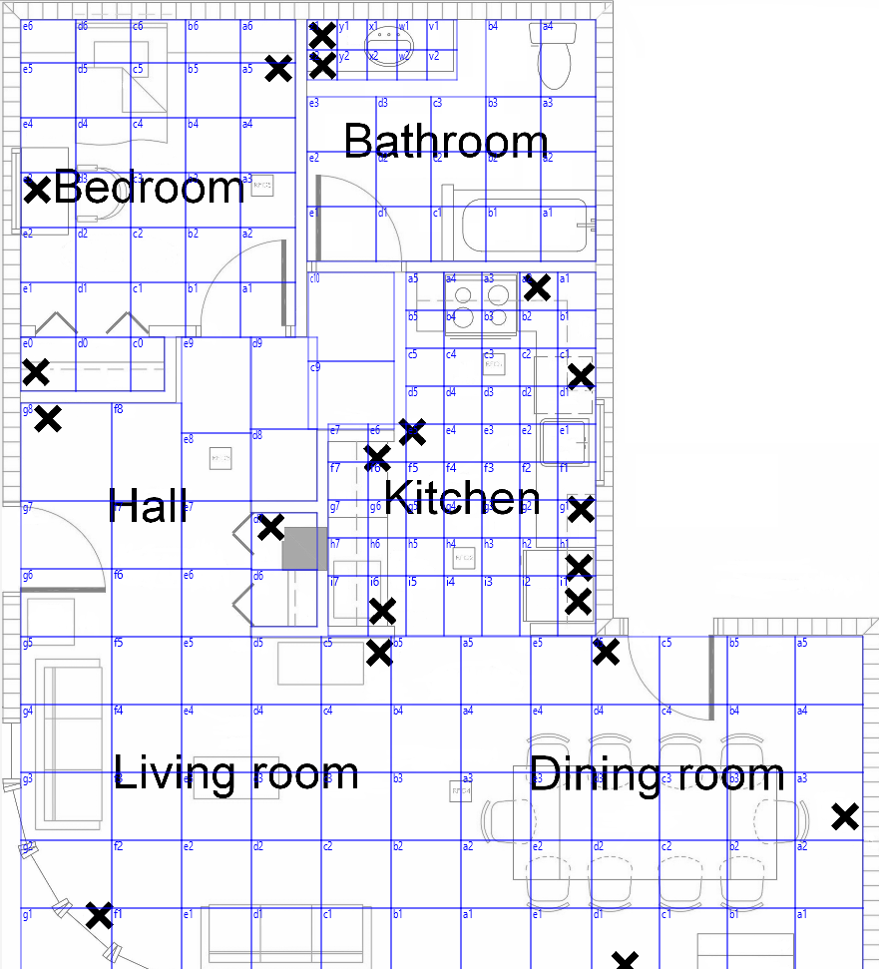
Indoor tracking system
Offline phase (training)
Divide the smart home into zones (40cmx40cm to 75cmx75cm)
Collect 50 training data in each zone
Train a random forest
Online phase
Collect readings
Stabilise using a moving average filter
Classify with the random forest
Prevent teleportation using zone filters
Notes:
Base of the activity recognition system

Slide 7
Indoor tracking system
190 zones
Zone filter allows movement in 8 directions
Takes walls in consideration
May be more than one neighboring zones in a given direction (zones of varying dimensions)
Accuracy of 97%
10-fold cross-validation
Random forest of 250 trees

Slide 8
Activity modelling
The activity recognition system has access to the position of objects
An activity is composed of interactions between 2 objects
3 types
SAME – Both objects are in the same zone
CLOSE – Objects are within X zones of each other, X small
FAR – When object that were previously CLOSE are separated
Limitations
Objects need to move at some point
Sometimes there may be only one object
Fake objects (consider environmental position as object, ex: kitchen sink)

Slide 9
Activity modelling
Interaction is composed of:
2 objects
Interaction type
Minimal time
Exemple: Pour water
2 objects: glass, sink
Interaction type: SAME
Minimal time: 5 seconds

Slide 10
Activity modelling
Interaction composition
Behaviour tree
Sequence node
Children are evaluated in order
All must complete
Parallel node
Children are evaluated concurrently
All must complete
Any node
Children are evaluated concurrently
Only one must complete

Slide 11
Activity modelling
Notes:
Expliquer l’ordre d’évaluation des nœuds
Temps 1: 1, 6, 2 Temps 2: 3 Temps 3: 4 et 5

Slide 12
Activity recognition
There are many instances of the same object (ex: many cups)
For each interactions, there are many candidates
One candidate for each possible pair of object
Evaluated each time the position of one of its object is updated

Slide 13
Activity recognition
Exemple
Pouring water into a glass
3 glasses (A, B, C)
2 sinks (K, T)
6 candidate interactions ({A,K}, {A,T}, {B,K}, {B,T}, {C,K}, {C,T})
Target: 5 seconds with interaction type SAME
One reading per second

Slide 14
Activity recognition

Slide 15
Activity recognition
Many objects can be equivalent for a task
Object taxonomy
Tree of objects
Much like in object oriented programing
Onthology
Current engine are too slow
Examples:
Pour water uses a recipient and a sink
Pour hot water uses a heat resistent recipient and a sink (or a kettle)

Slide 16
Activity recognition
Activity probability based on the progression of its interactions
Can be seen as a score
Can then be combined with any source
User’s habits
Time of day
Machine learning
Activities can be combined using the behaviour tree to form meta-activities

Slide 17
Conclusion
We describe a system that can achieve activity recognition using only the relative position of objects
Behaviour tree can be used to order interactions or activities
It is important to consider the object categories for flexibility
Activity can easily be described by a non expert with minimal knowledge

